Slide 1

Saturday, 11th November, 2023
___________________________
TEAM NEURAL CRAFT
Predicting School Attendance Rate in Sub-National African Countries (Using Educational Infrastructure)

Slide 2


Our Team
Other Active Members
Aberejo Habeeblah
Presenter 1
Caleb Balogun
Presenter 2
Project Lead:
Tochukwu Collins
Assistant Project Lead:
Qudus Bello
Query Analyst:
Chukwuegbo Love
Caleb Balogun | Model Development
Onyebuchi Mkpuluma | Visualization
Aberejo Habeeblah | Presenter

Slide 3
Problem Statement
In subnational African countries, forecasting school attendance rates is essential for effective education planning and resource allocation.
This project hope to address this issue by developing machine learning models that predict attendance rates based on a comprehensive analysis of educational and socio-economic factors.
If this problem is solved, improving attendance predictions will empower education policymakers to enhance resource allocation and educational outcomes in these regions.
The problem we are trying to solve is to determine attendance rate which can helps in educational infrastructure like building, equipments, instructors for the students.

Slide 4
Aim
The aim of this project is to develop accurate machine learning models for predicting school attendance rates in subnational African countries, utilizing educational and socio-economic factors as key predictors.

Slide 5
Our Approach
Feature Selection: Identify the most relevant features that impact school attendance rates within the selected regions from the data provided.
Model Development: Create machine learning models that leverage the chosen features to predict school attendance rates with a high degree of accuracy.
Model Evaluation: Assess the performance of the developed models through rigorous testing and validation using historical attendance data.

Slide 6
Dataset Description
The dataset, compiled by Climate Change and African Political Stability (CCAPS), whose focus is analyzing how climate change, conflict, governance, and aid intersect to impact African and international security.
The dataset features provides data on literacy rates, primary and secondary school attendance rates, access to improved water and sanitation, household access to electricity, and household ownership of radio and television at the subnational level, specifically the first administrative district level.
The dataset contains values between the year 2003 to 2011 in regions within Africa.
The dataset has a shape of (471, 68) which interpretes that there are 471 regions in 38 African countries with 68 columns.

Slide 7
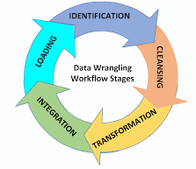
Dataset Description
Below is a flowcharts diagram explain how the data wrangling, processing and exploration is done.
Identification: Getting our data
Cleansing: Identifying data quality issues like null values and getting rid of them.
Transformation: Making a new copy of our dataset into a usable format.
Loading: Moving the cleaned unified data into algorithms for model building.
Codes addressing all of this can be found in the respective cells of the Colab file

Slide 8
Dataset Description
The cleaning of the dataset include filling column with less than 10 missing values with the mean of the column in the dataset. Such columns include Television (% of pop) sample size, Radio and/or Television in household (% of population), Access to improved water (% of households).
We built a simple model to predict the values for columns that have missing values within the range of 11 to 23. Such columns include Electricity (% of hh) sample size, Radio in household (% of households), Radio
Columns with missing values that’s above 30 were totally dropped, this is because our dataset isn’t that large to have missing column of about 124 as in some column like Literacy rate (15 & over), Literacy rate (15-24), Literacy rate (25-49).

Slide 9
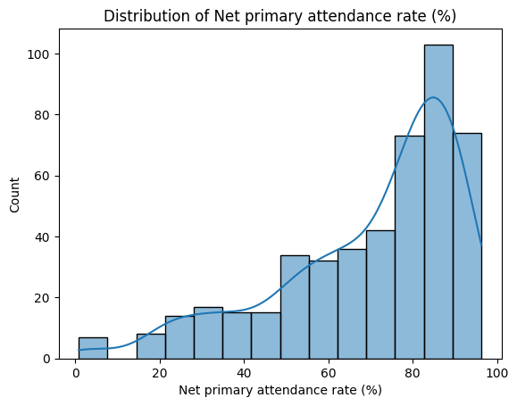
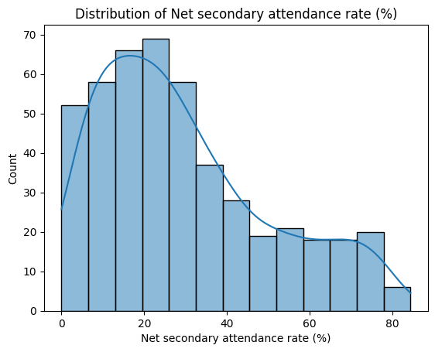
Dataset Description
The histogram below tell number of regions in relation to the attendance rate (both Primary and Secondary)

Slide 10
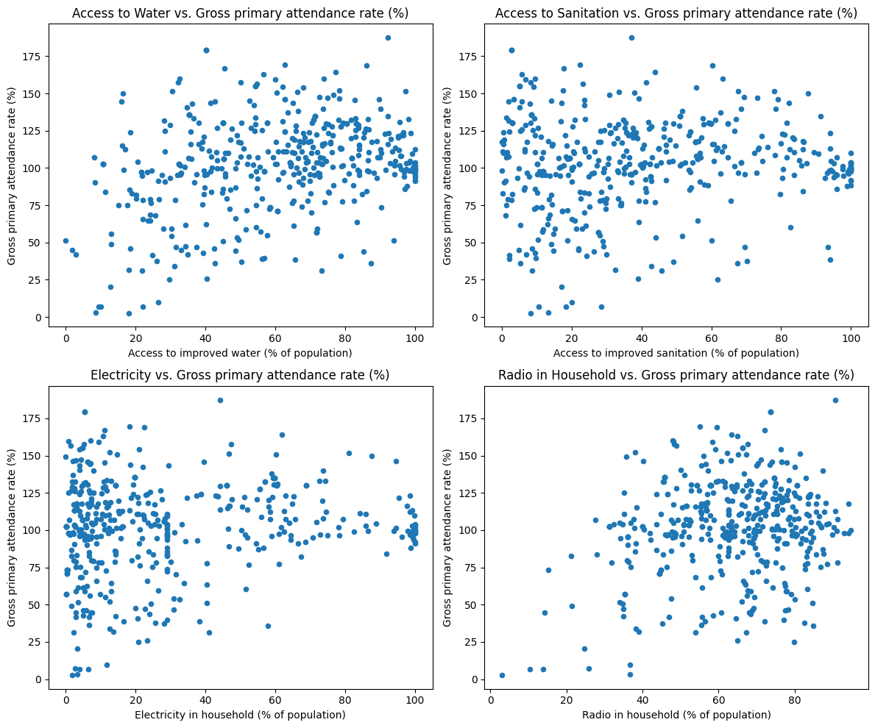
Dataset Description
The scatterplot here plots the relation between some of our features to primary attendance rate
A detailed PowerBI report can be found via the link below, https://app.powerbi.com/view?r=eyJrIjoiY2JlODBjYTItMDlmMy00MDM4LTgzYTItN2NlNDVlMGZlYzczIiwidCI6ImRmODY3OWNkLWE4MGUtNDVkOC05OWFjLWM4M2VkN2ZmOTVhMCJ9

Slide 11
Dataset Description
After the EDA, we decide go build model with the features below
Access to improved water (% of population)
Access to improved sanitation (% of population)
Electricity in household (% of population)
Radio and/or television in household (% of households)

Slide 12
Modeling
Machine Learning Models: We utilized ML models like
Support Vector Regression
K-Nearest Neighbors Regression
XGBoost Regression.
Evaluation Metrics: Model performance was evaluated using evaluation metrics like
Mean Squared Error (MSE)
Mean Absolute Error (MAE)
R-squared (R2_Score)

Slide 13
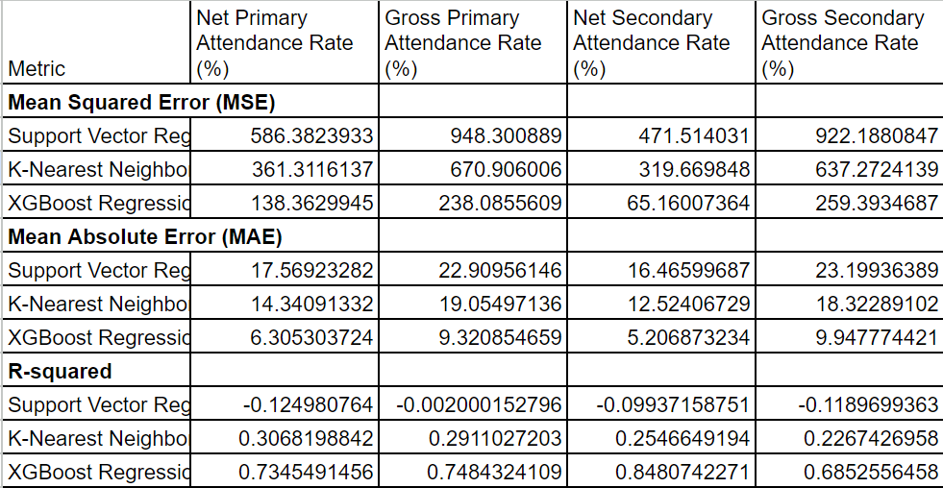
Modeling: Result from evaluation metrics

Slide 14
Conclusion
Key Findings:
XGBoost Regression Model is recommended for attendance rate prediction in educational institutions because it has the lower MSE Value, lower MAE value higher R2Score value as needed by a good model.
Conclusions:
The XGBoost Model successfully predict attendance rate with good accuracy.

Slide 15
Summary
Training the model after thorough data preprocessing techniques, the model was evaluated with evaluation metrics which include, R2Score, MAE, MSE which gave general comment on the model and the XGBoost model can be considered ready for Real-world deployment of solution.
We recommended that attention is given to regions with lower attendance rate

Slide 16

Thank You

